Slide 1

April 2025 & 2026 Change Days: Proposed Service & Fares Changes​
Virtual Public Meeting
November 20, 2024
5:30-7pm

Slide 2
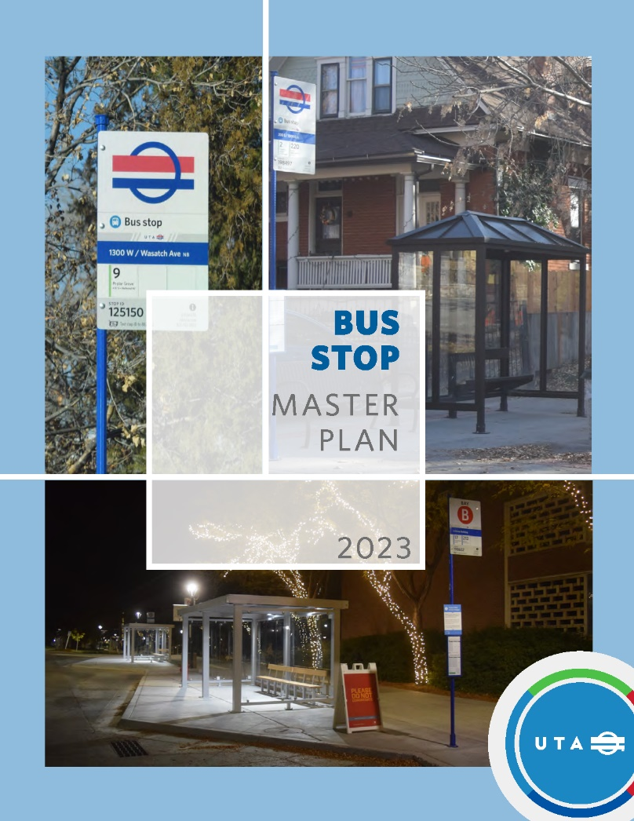
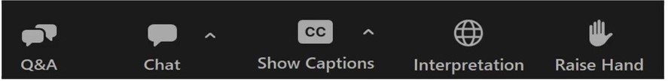
How to Engage During the Session
Chat: utilize this for any questions, feedback, etc. you’d like to write
Q&A: similar to the chat, you may type your questions here
Raise Hand: We may use this function if time allows for attendees to voice their question
Show Captions: turn on captions to have a live transcription of the session
DRAFT – INTERNAL REVIEW ONLY

Slide 3






Purpose of the Five-Year Service Plan
Improve employee working conditions
by reducing split shifts, more consistent service throughout the day
Implement Long-Range Transit Plan
and prepare for future service / projects
Respond to community feedback
Optimize the system
for more access within our current limits
Restore service
in areas where it was previously reduced

Slide 4
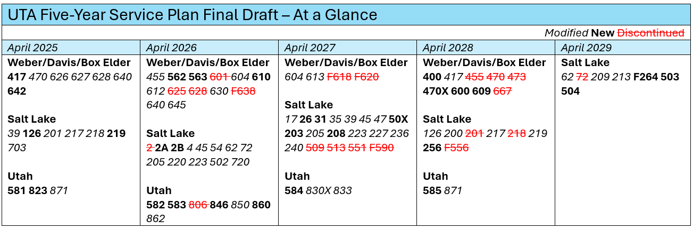
Five-Year Service Plan → Change Day

Slide 5
What’s a “major change”?
Major changes are changes that are required to undergo a Title VI analysis and public engagement process based on the following criteria:
  Addition of service: meaning the creation of a new bus route or the opening of a new rail line
  Proposed service level change in miles, hours, or trips of 33% or more
  Elimination of all service during a time period (peak, midday, evening, Saturday, or Sunday)
  Proposed 25% or greater change in route alignment
  Proposed fare change

Slide 6
April 2025
Service Changes
* denotes major change

Slide 7
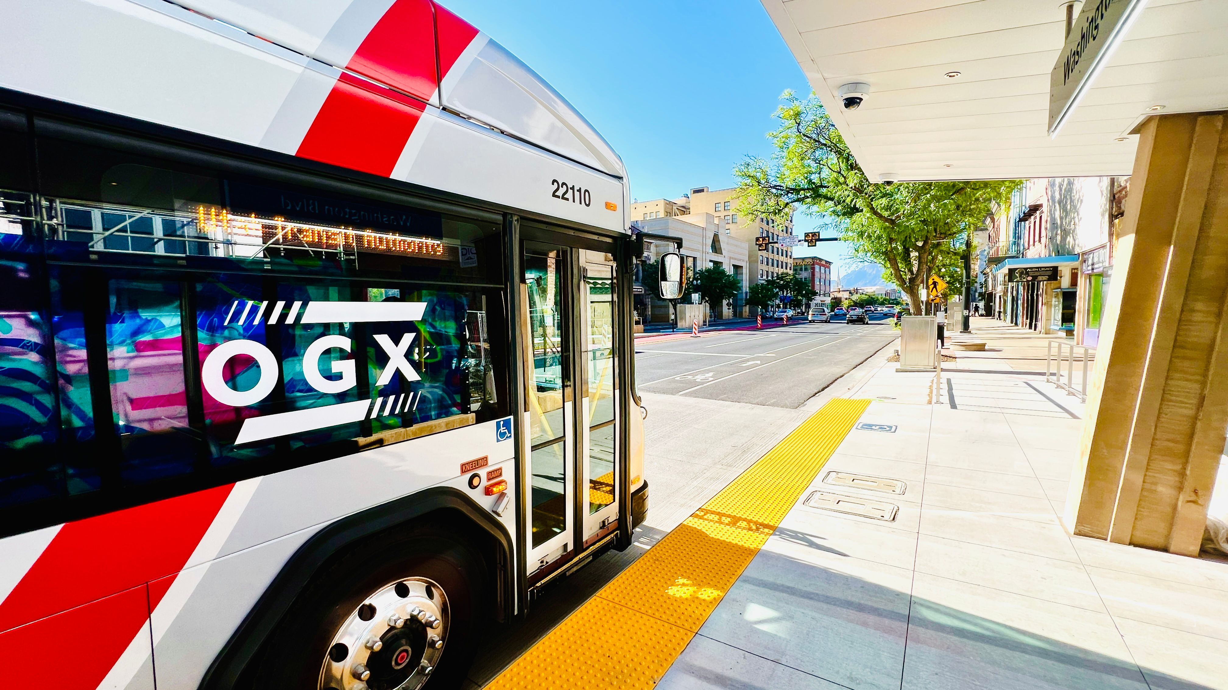
Weber, Davis, Box Elder Counties
April 2025
Notes:
Marcus

Slide 8
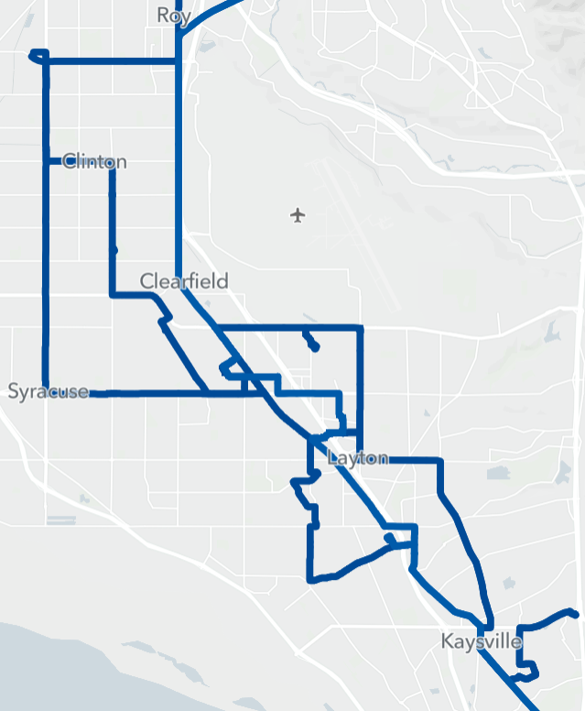



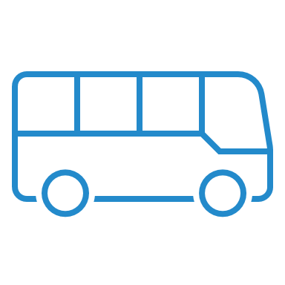
Weber-Davis Regional Service
470
640
Route 470: Serve Layton Hills Mall
Route 626*: Replaced by modified route 640
Route 627*: Extend to Fruit Heights Park & Ride, reroute to maintain coverage
Route 628*: Replace trolley with local service
Reroute to serve new coverage areas in Layton
Route 640*: Shorten to Clearfield Station
Reroute to 5600 South, 2000 West
Route 642*: New route serves Freeport Center
642
628
640
470
Layton Hills Mall
470 627 628 640
Clearfield Station
470 627 628 640 642
627
628
Fruit Heights P&R
455 473 627
470
Hours | Miles | Shifts | Pullout
+5K | -1.2K | +2 | -5
Notes:
Routes 626, 640: Exchange routing between Antelope Drive and 1800 North. Route 626 will serve the Freeport Center and route 640 will serve 2000 West. This change sets route 640 up for additional changes in 2026 and provides a connection between the two routes at the north end of route 626 that does not exist today.

Slide 9
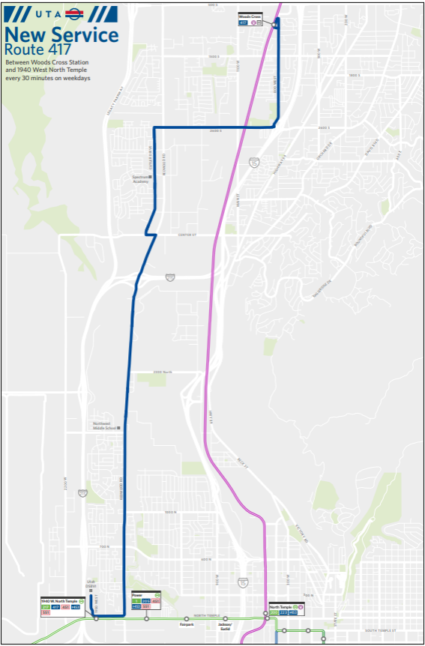

Slide 10
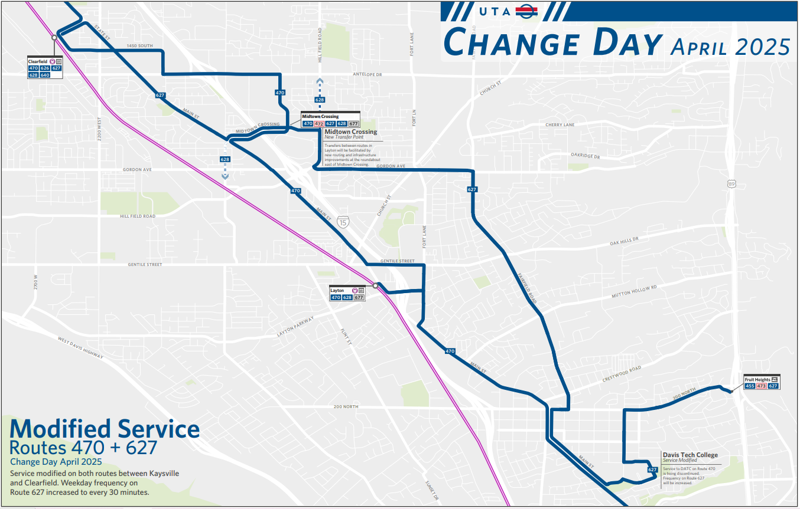

Slide 11
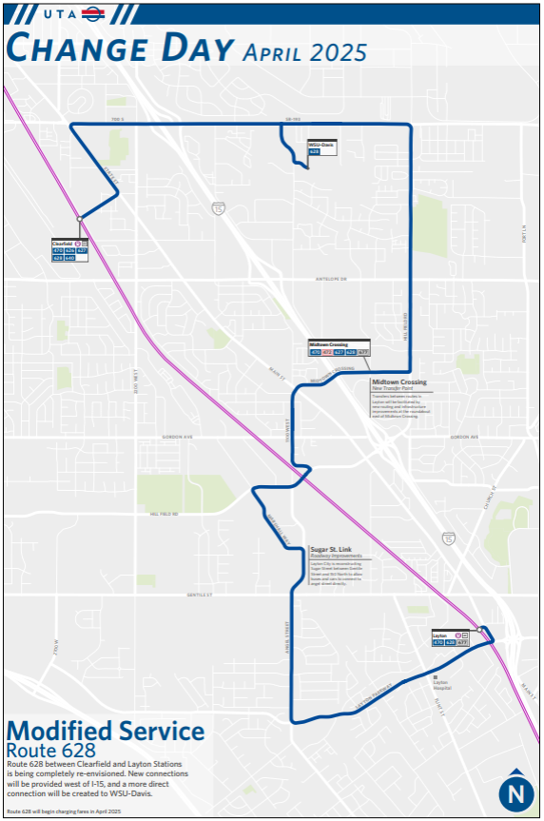

Slide 12
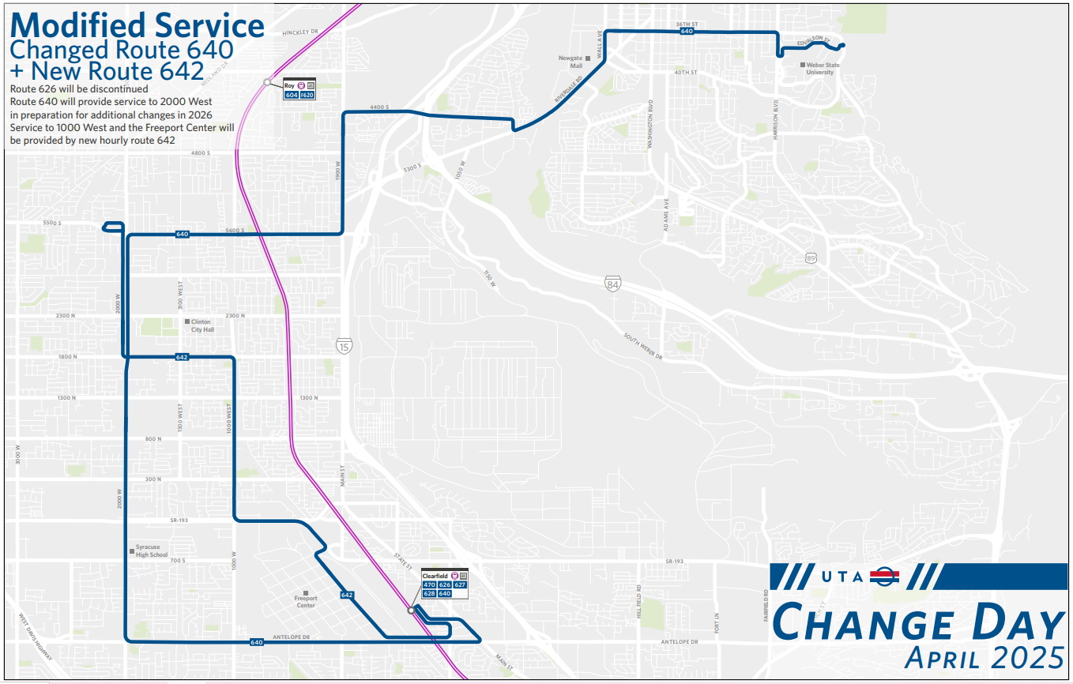

Slide 13
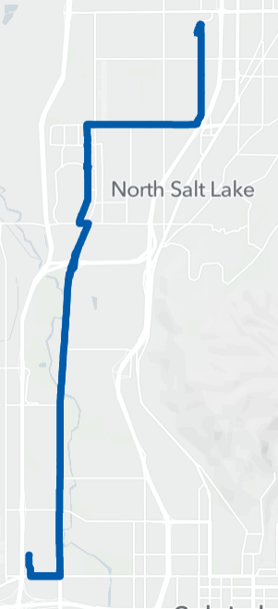
Weber-Davis Regional Service
Woods Cross Station
417 561
Route 417*:
New route between North Temple and Woods Cross Station
Route 217
End of line adjustment
Community Priority
417
Power Station
1 205 217 417 451 F453 502
Hours | Miles | Shifts | Pullout
+19K | +206K | +9 | +4
Notes:
Route 417: In the original draft plan, route 417 continues north from Woods Cross Station to Orchard Drive and Legacy Crossing in Centerville. This route has been identified as a high priority in UTA's public engagement. For quick implementation in 2025, UTA will implement only the portion of route 417 between North Temple/1950 West and Woods Cross Station. This portion includes Northwest Middle School and Spectrum Academy. The full route 417 is proposed to be implemented in 2028 in conjunction with the opening of the Davis-Salt Lake Community Connector.
When route 417 begins service, route 217 north EOL will move from DSBVI on 1950 West to Redwood Rd/North Star Drive, a few blocks to the east. Route 417 will use the current 217 EOL at DSBVI.

Slide 14
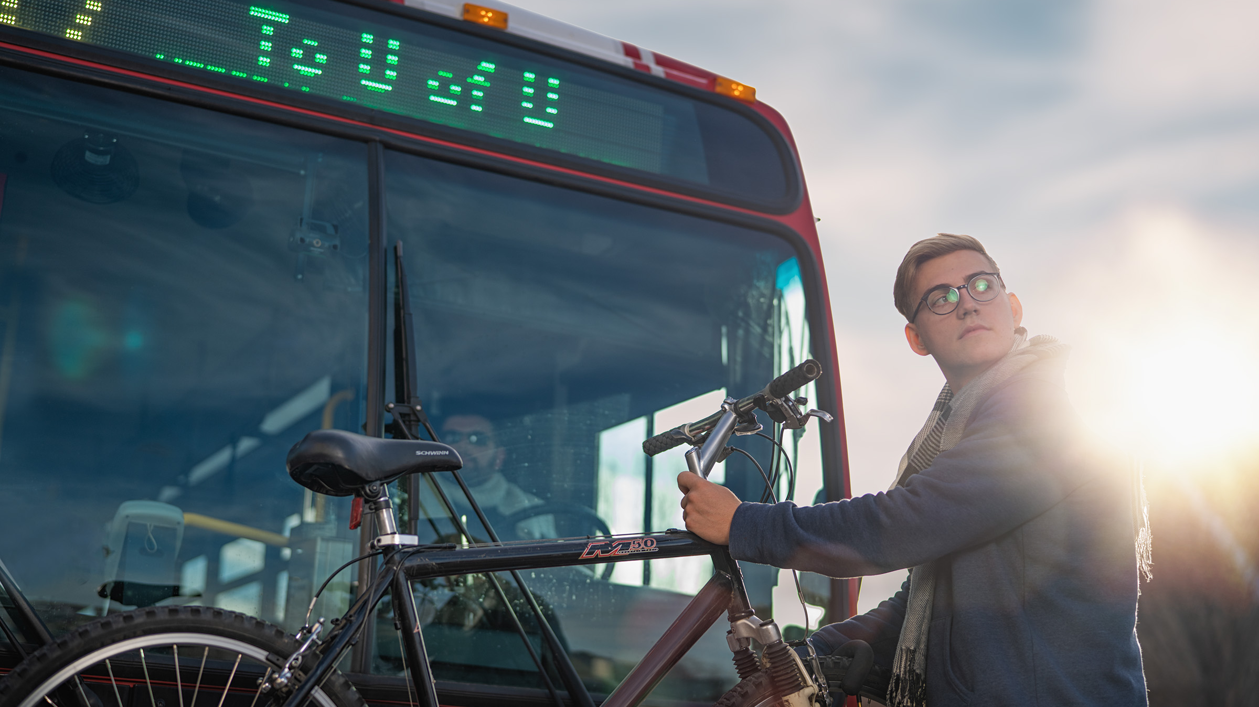
Salt Lake County
April 2025
Notes:
Marcus

Slide 15
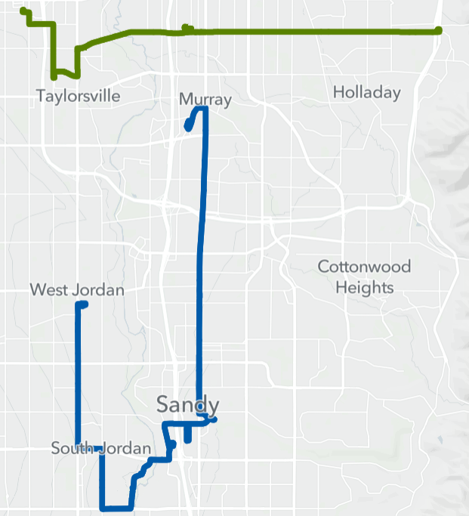


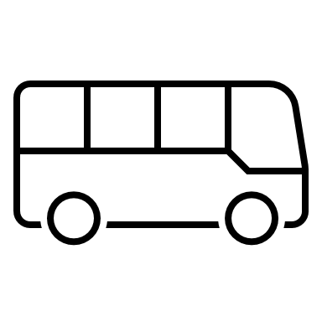
Salt Lake County Local Service
Meadowbrook Station
39
Route 39:
Increase service to 15-min
Routes 201, 218:
Increase service to 30-min
Community Priority
Murray Central Station
45 47 54 200 201
201
218
Sandy Civic Center Station
201 219 F514 F525 871
South Jordan Station
201 F202 218 219 F514
Hours | Miles | Shifts | Pullout
+21K | +264K | +9 | +6

Slide 16
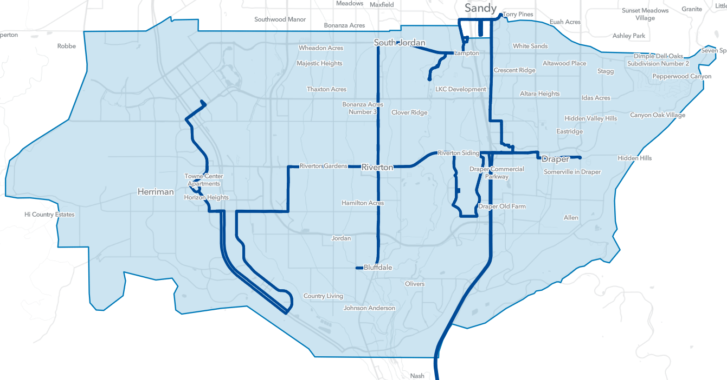
Herriman/Riverton/Draper/Bluffdale
Sandy Civic Center Station
201 219 F514 F525 871
Route 126*:
Implement new route
Serves SLCC, Real Salt Lake Academy
Modified alignment until street network is complete
Route 219*: Implement new route
Modified alignment until The Point station opens
Community Priority
Daybreak Parkway Station
126 501
871
219
126
Draper Town Center Station
126 501
Draper Station
126 501 F514
SLCC Herriman Campus
126 501
Hours | Miles | Shifts | Pullout
+22K | +333K | +15 | +9
Includes +2 pullout, +4 shifts for Paratransit
Notes:
Routes 126, 219: In the draft 5YSP, these routes were planned based on the best understanding of the street network after 5 years. Service improvements in this area have been identified as a high priority in community feedback. To implement these routes by April 2025, these routes will have to be modified from their original version until the street network and The Point Station are complete.

Slide 17
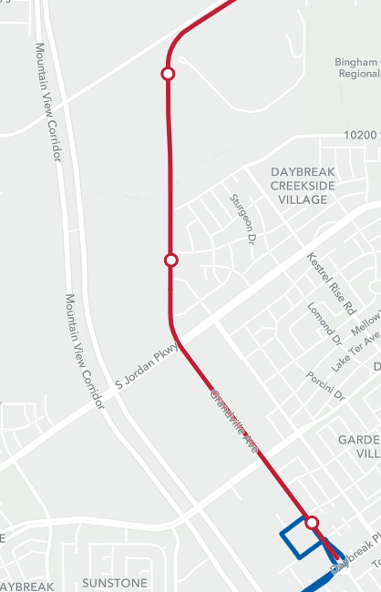

South Jordan Downtown Station
5600 West Station
Red Line:
New South Jordan Downtown Station opens
South Jordan Parkway Station
South Jordan Downtown Station
Daybreak Parkway
Station
126
Hours | Miles | Shifts | Pullout
0 | 0 | 0 | 0

Slide 18
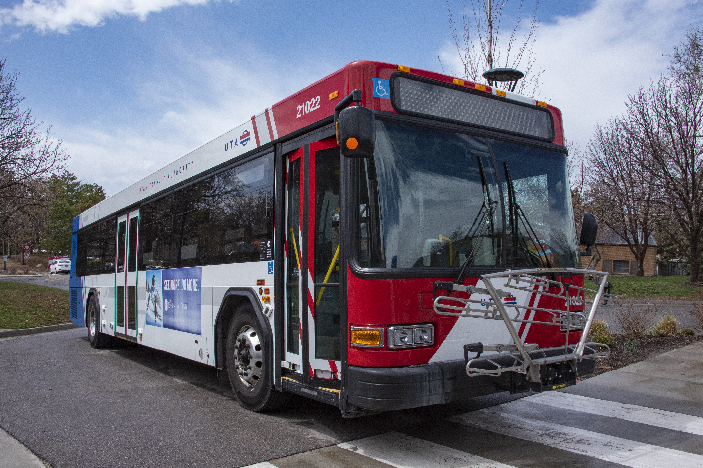
Bus Service Increases
Route 39
Weekday: 15-min
Saturday: 15-min
Sunday: 30-min
Route 201
Weekday: 30-min
Saturday: 60-min
Route 218
Weekday: 30-min
Saturday: 60-min
New TRAX Station
South Jordan Downtown Station
(Red Line)

Slide 19
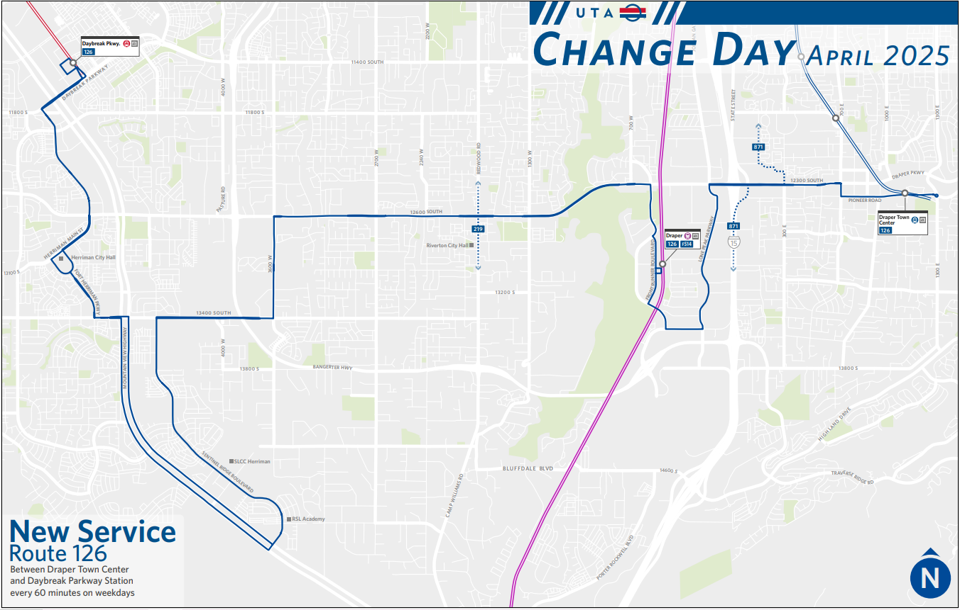

Slide 20
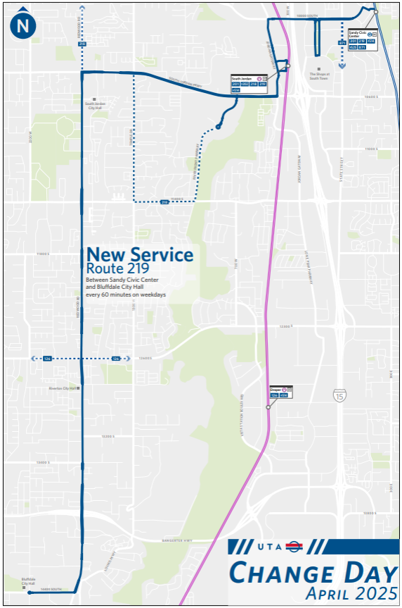

Slide 21
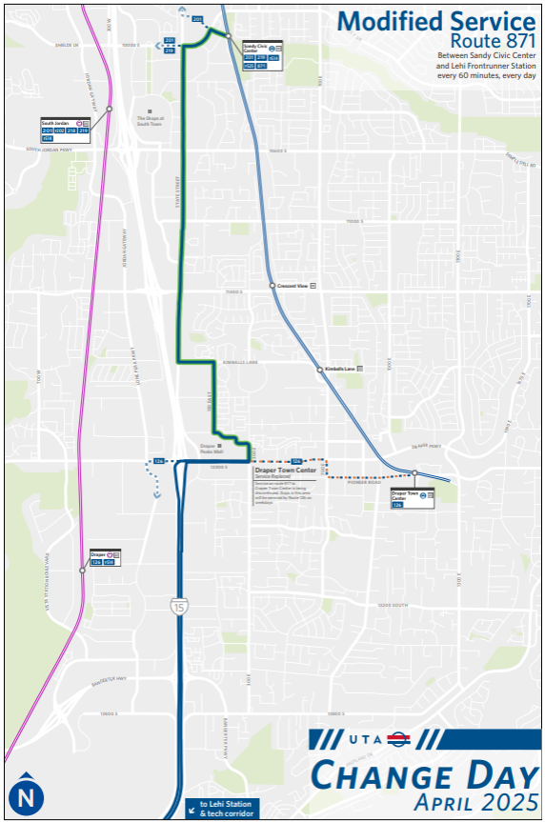

Slide 22
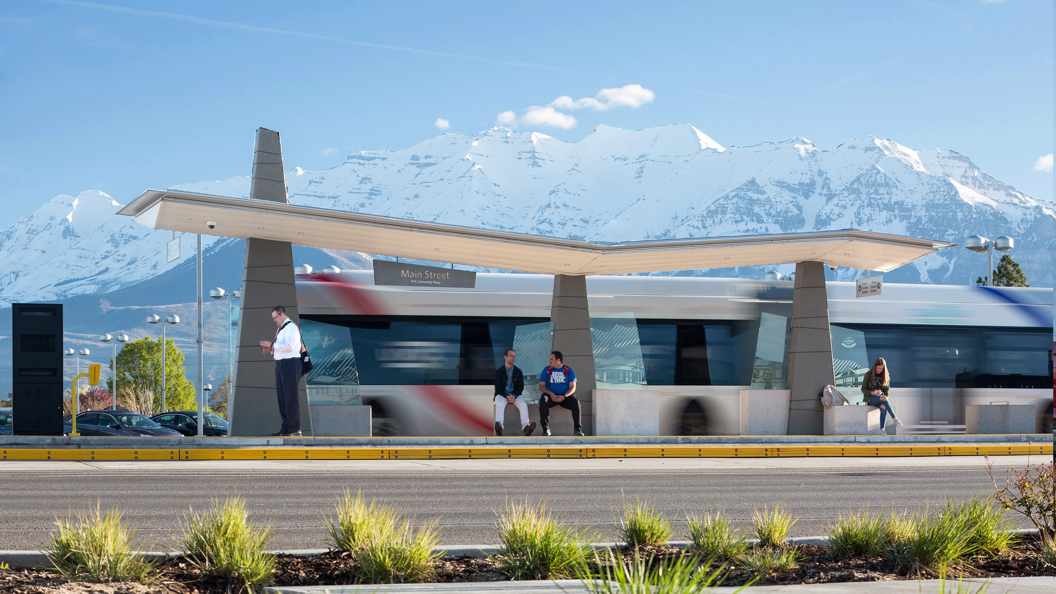
Utah County
April 2025
Notes:
Marcus

Slide 23
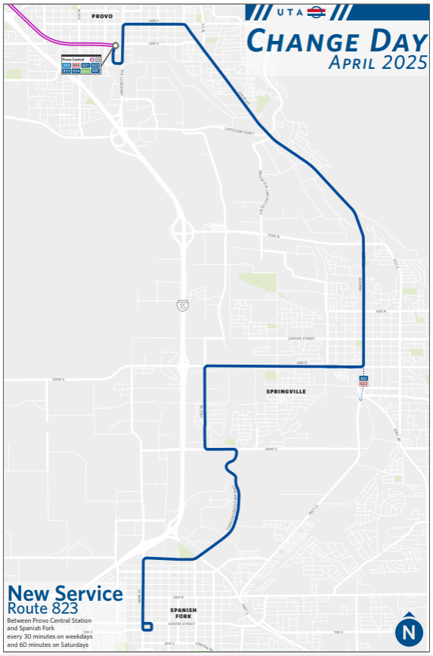

Slide 24
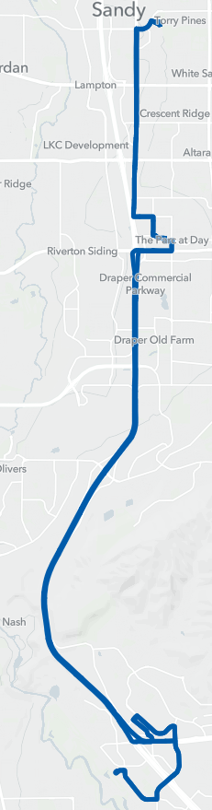
Lehi-Sandy
Sandy Civic Center Station
201 219 F514 F525 871
Route 871: Extend to Sandy Civic Center Station
Lehi Station
806 807 850 871
Hours | Miles | Shifts | Pullout
+3.8K | +30K | +2 | +1

Slide 25
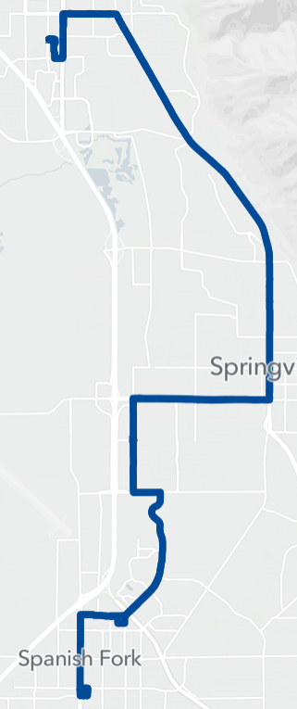
South Utah County
Provo Station
581 805 821 823 830X
831 833 834 850
Route 823*:
New route
Community Priority
Hours | Miles | Shifts | Pullout
+20K | +276K | +10 | +5

Slide 26
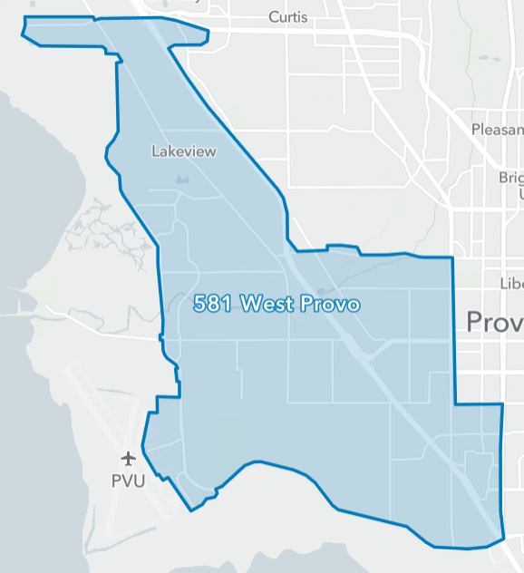
West Provo/Airport
Zone 581*:
New UTA On Demand zone
Hours | Miles | Shifts | Pullout
+10K
Notes:
Add for stakeholder support for added service to the airport

Slide 27
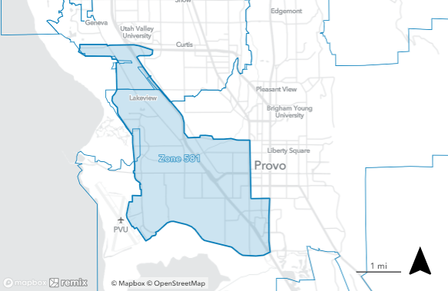
Zone 581
New UTA On Demand zone
Service 6 AM – 9 PM on weekdays

Slide 28
April 2026
Service Changes
* denotes major change

Slide 29
Weber, Davis, Box Elder Counties
April 2026
Notes:
Marcus

Slide 30
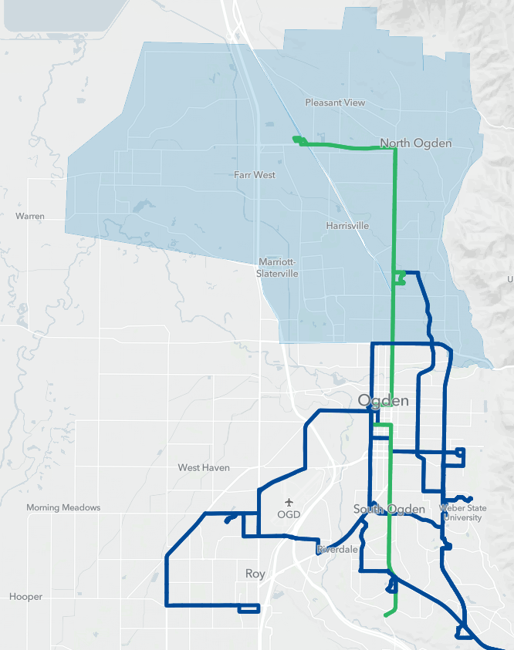
Ogden Local Service
Pleasant View Station
612 630
Route 455: Shorten to Dee EC
Route 604*: Extend to WSU (replaces route 455)
Route 610*: New local service connects destinations throughout Ogden (replaces portions of routes 612, 625)
Route 612:
Serve Pleasant View, Ogden Stn
Serve Washington Terrace/South Ogden via Adams Avenue Pkwy (replaces 601 trolley)
Route 645*: Increase to 30-min service; reroute to avoid duplication with OGX; extend to Roy Station
New IMZ service*; Ongoing Paratransit analysis
612
645
Ogden Station
470 473 600 604 610 612
613 F618 F620 630
Community Priority
610
604
Roy Station
604 F620 640 645
610
645
Dee Events Center
455 602 603X 604 610
612
604
455
Hours | Miles | Shifts | Pullout
+37K | +614K | +20 | +3
Notes:
Route 455: This route is proposed to be discontinued with the opening of Davis-Salt Lake Community Connector, with portions of the route covered by new Ogden local service. Now that the Draft 5YSP is phased, the Ogden local service changes will happen before Davis-Salt Lake opens, so this portion of route 455 will be discontinued and replaced before the rest of the route.
Route 612: Based on internal and external feedback, route 612 will not end at Ogden Station. It will continue south on Washington Blvd to Adams Avenue Parkway. The area of Washington Terrace currently served by route 612 will still be replaced by route 610.

Slide 31
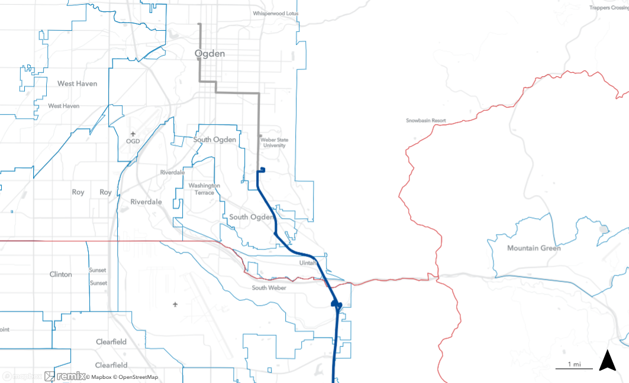
Wall Ave
Washington Blvd
Route 455
Shorten to Dee Events Center (replaced by route 604)
Ogden Station
28th St
30th St
Harrison Blvd
Dee Events Center
455
(continues to Davis Co.)

Slide 32
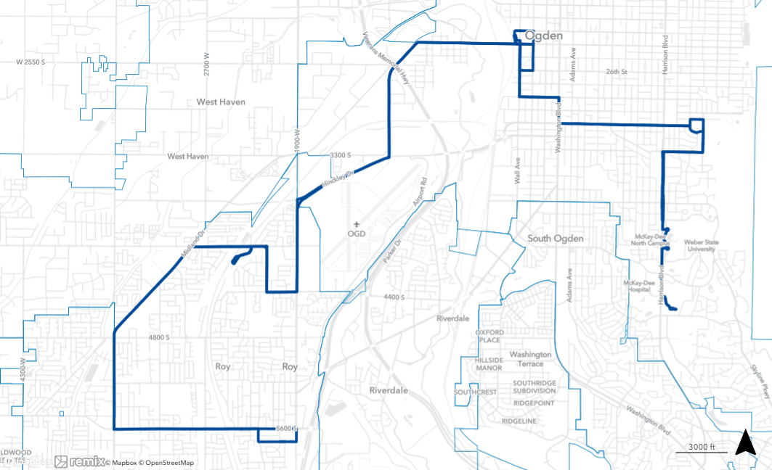
Ogden Station
Route 604
Extend to Dee Events Center (replaces route 455)
24th St
28th St
Pennsylvania Ave
30th St
Darling St
Polk St
32nd St
Taylor Ave
Harrison Blvd
Dee Events Center
1900 W
4000 S
2175 W
Roy Station
4400 S
Dee Events Center
3500 W
2200 W
5700 S

Slide 33
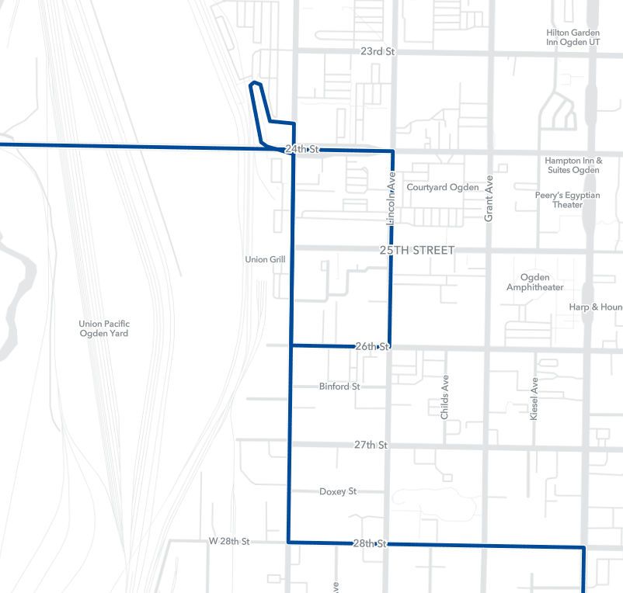
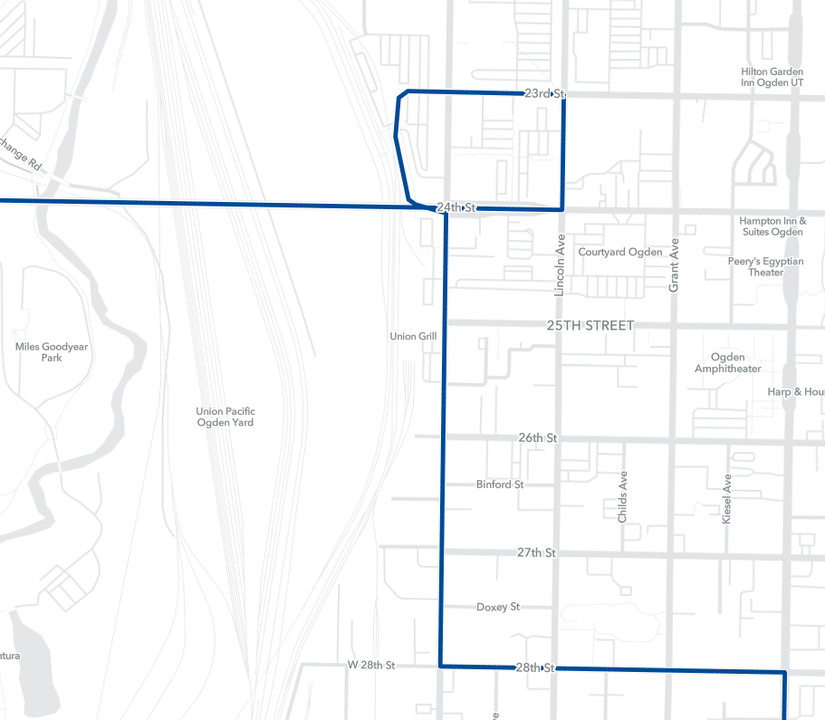
Ogden Station
Ogden Station
604 toward Roy
604 toward Dee Events Center

Slide 34
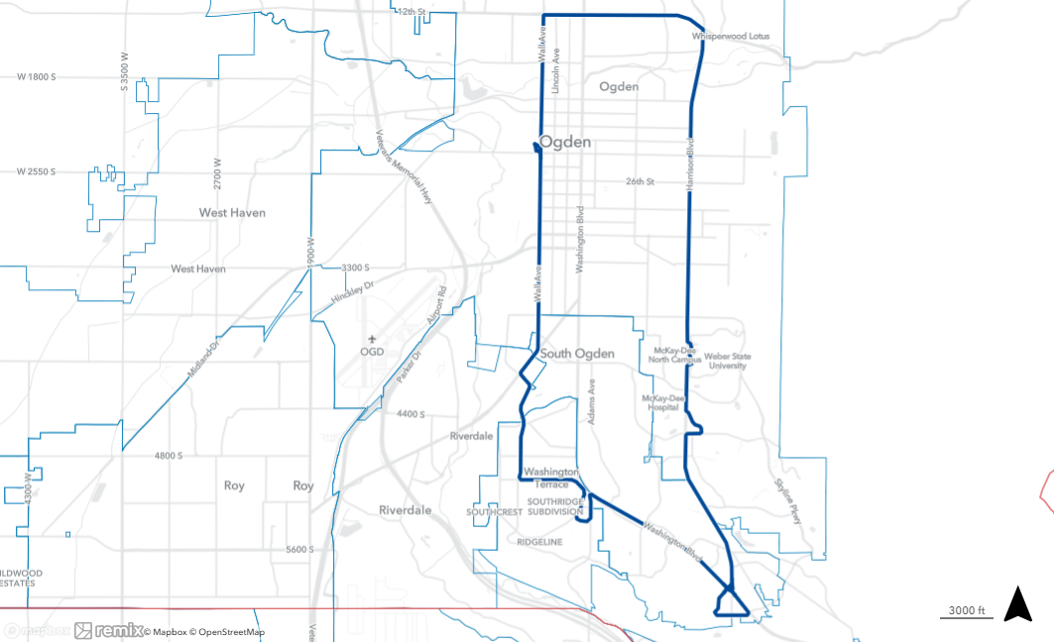
12th St
Route 610
New route
Loop service in both directions
30-minute service weekday; 60-minute service Saturday
Replaces portions of routes 612, 625
Ogden Station
Riverdale Rd
300 W
Dee Events Center
5000 S
5350 S
Adams Ave Pkwy
Ogden Regional Hospital
Ridgeline Dr
Skyline Dr

Slide 35
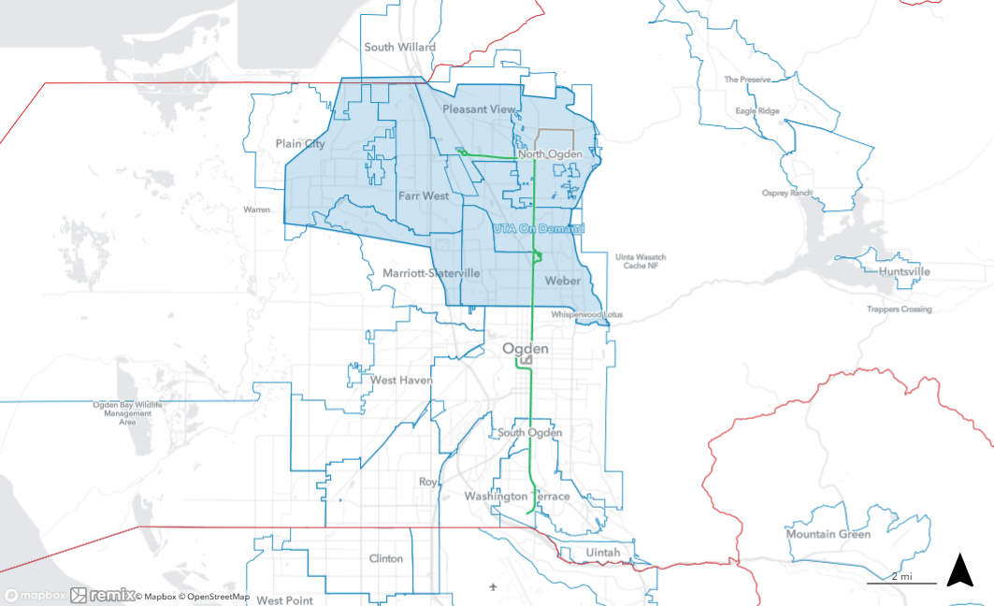
Route 612
Rerouted to serve Ogden Station (replaces 601 trolley)
Extended to serve Pleasant View Station
North Ogden loop replaced by UTA On Demand
Streamlined in Washington Terrace (portions replaced by route 610)
Pleasant View Station
Ogden Station

Slide 36
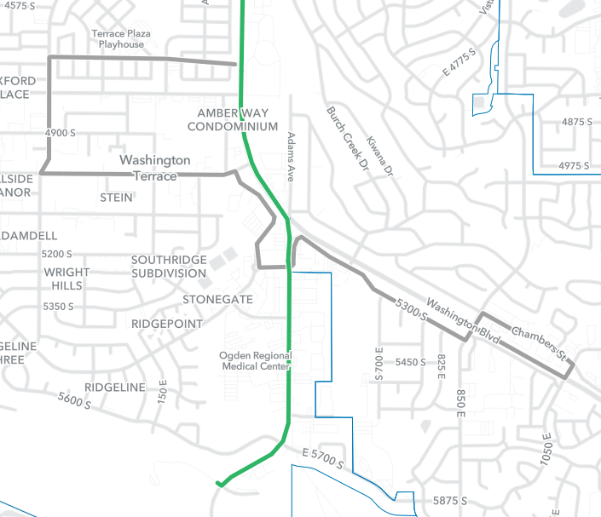
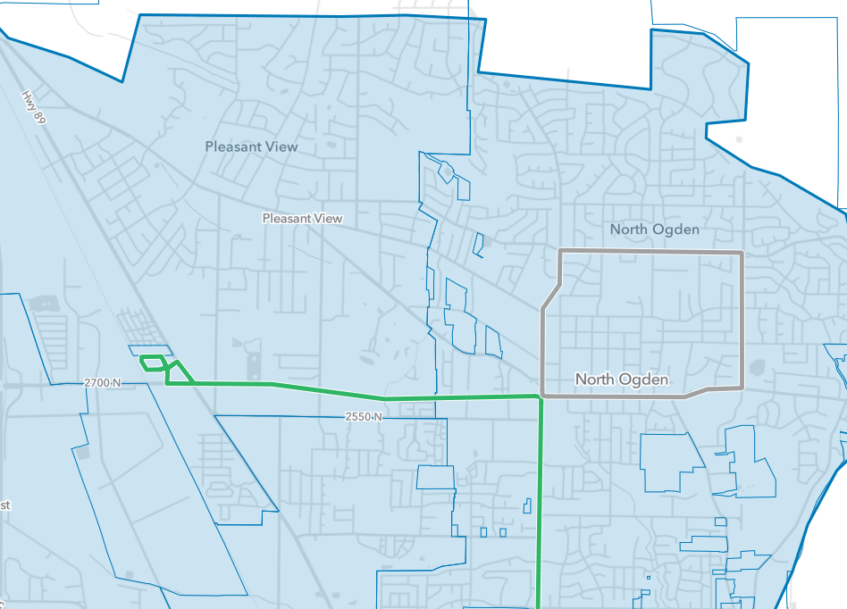
300 W
Navy Way
Washington Terrace
450 E
5000 S
Pleasant View Station
3100 N
1050 E
2700 N
Adams Ave Pkwy
Washington Blvd
North Weber

Slide 37
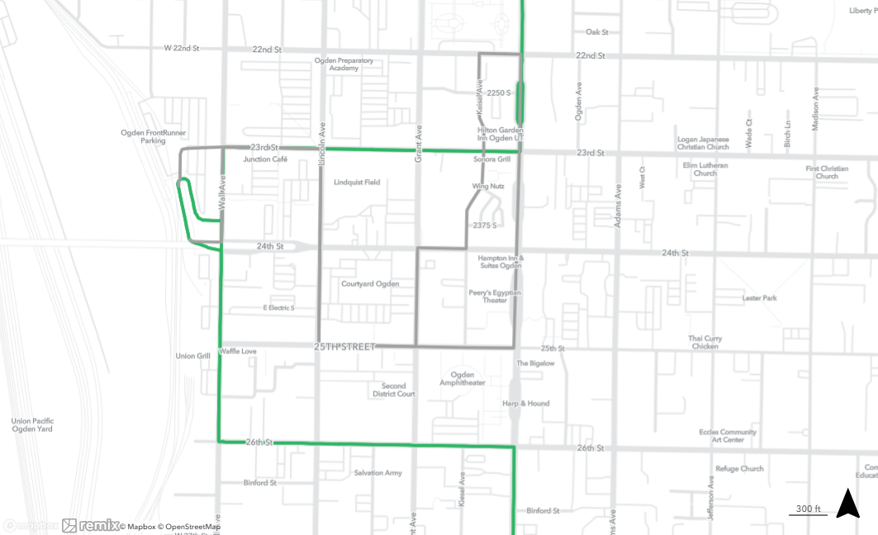
Downtown Ogden

Slide 38
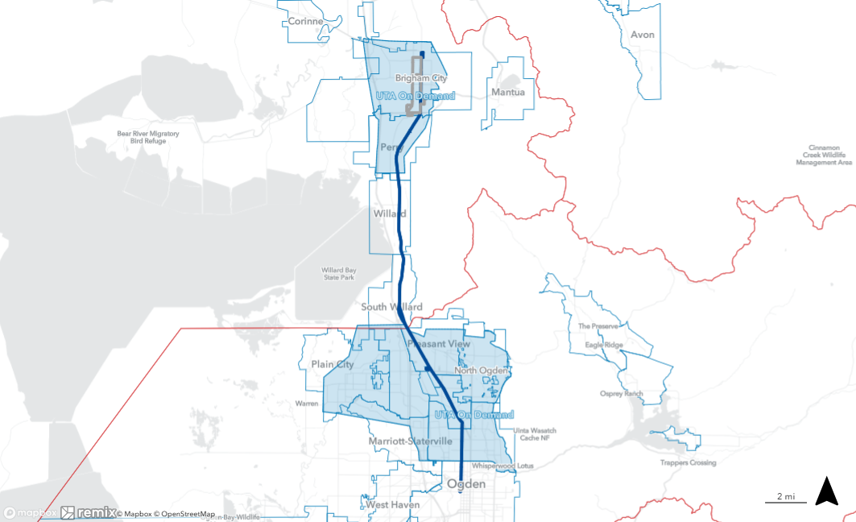
Route 630
Streamlined in Brigham City (replaced by on-demand service)
Service increased to 30-min on weekdays
Begin serving Pleasant View Station
Pleasant View Station
Ogden Station

Slide 39
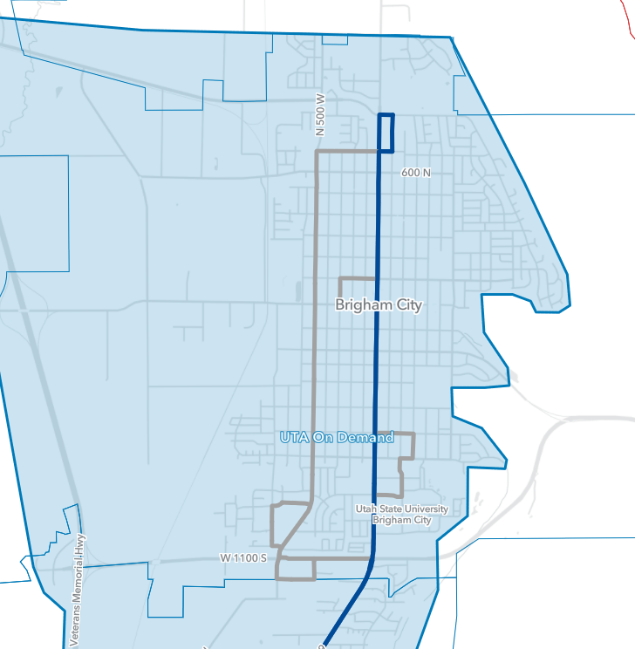
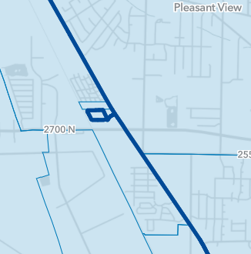
700 N
Pleasant View Station
Main St
800 W
Medical Dr
950 S
350 W
1100 S
1200 S

Slide 40
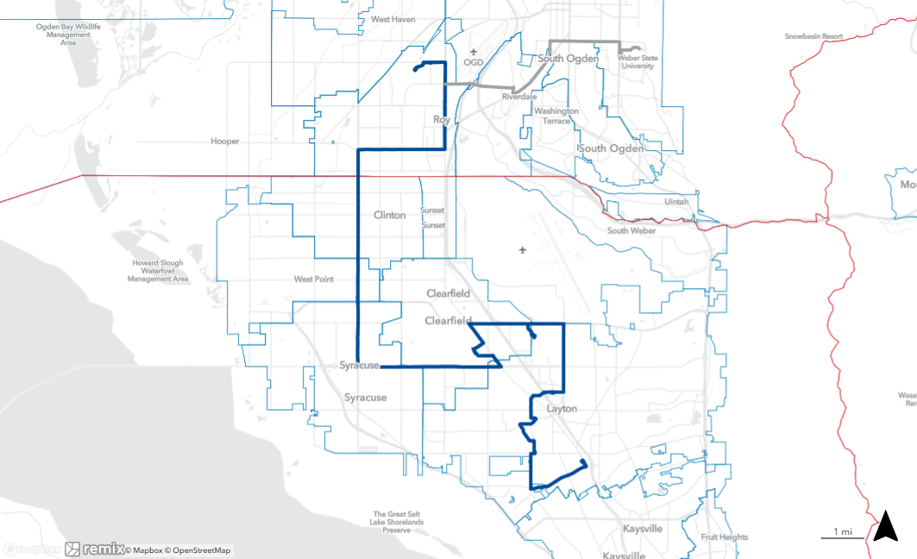
Wall Ave
36th St
Edvalson St
Route 640
Shortened to Roy Station (replaced by route 645)
Extended to Layton Station (replaces route 628)
700 W
Roy Station
1900 W
4400 S
Riverdale Rd
3500 W
5600 S
2000 W
700 S/Hwy 193
Clearfield Station
Main St
Hill Field Rd
Antelope Dr
Midtown Crossing
Hill Field Rd
Layton Station
Marshall Way
Sugar St
Gentile St
Angel St
Layton Pkwy

Slide 41
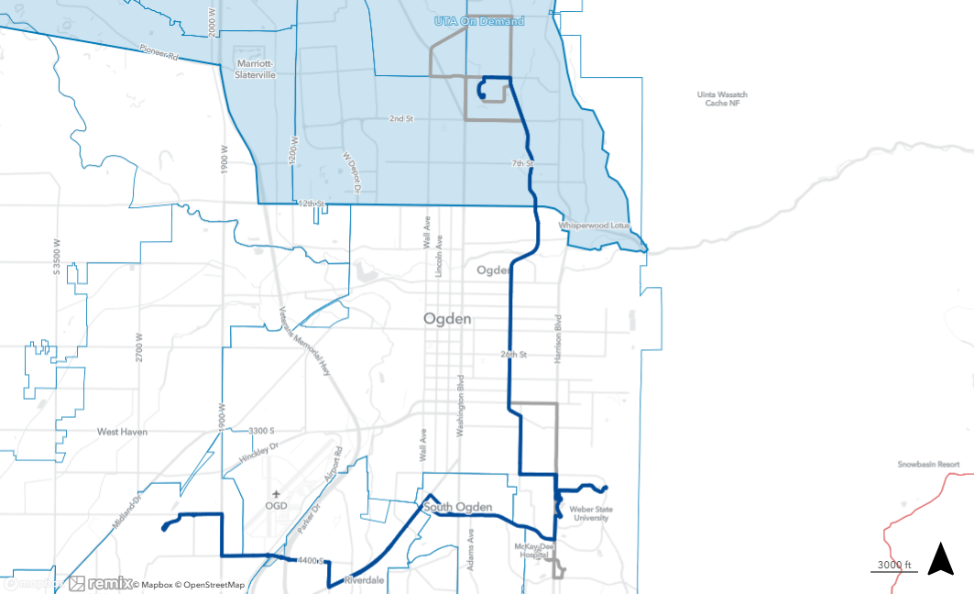
1100 N
Larsen Ln
Wall Ave
Monroe Blvd
Route 645
Weekday service increased to 30-min
Extended to Roy Station (replaces route 640)
Shortened to OTC (replaced by on-demand service)
Monroe Blvd
30th St
Sullivan Ave
Quincy Ave
36th St
Edvalson St
4000 S
Roy Station
Riverdale Rd
40th St
700 W

Slide 42
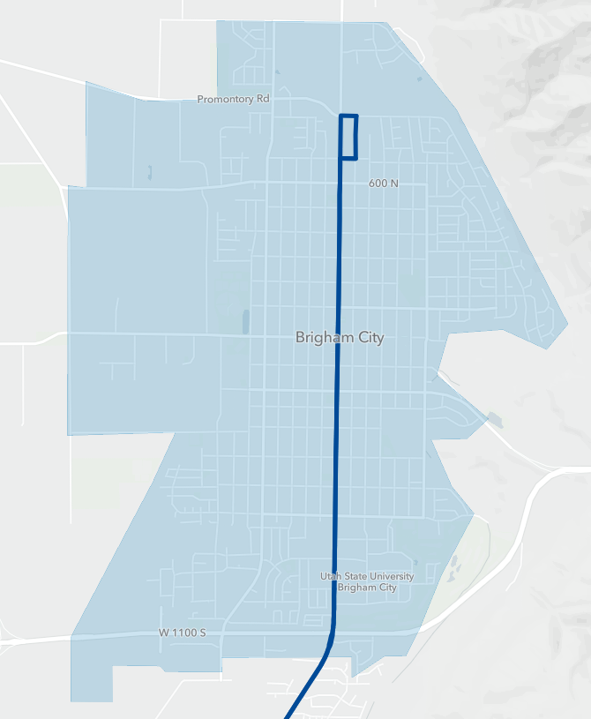
Brigham City
Route 630*: Serve Pleasant View Station
Increase service to 30-min
New IMZ Service*
Replaces route F638*
630
Hours | Miles | Shifts | Pullout
+5.7K | +186K | +3 | 0
Notes:
Please add the notes for these routes
Start EOL an corridor

Slide 43
Salt Lake County
April 2026
Notes:
Marcus

Slide 44
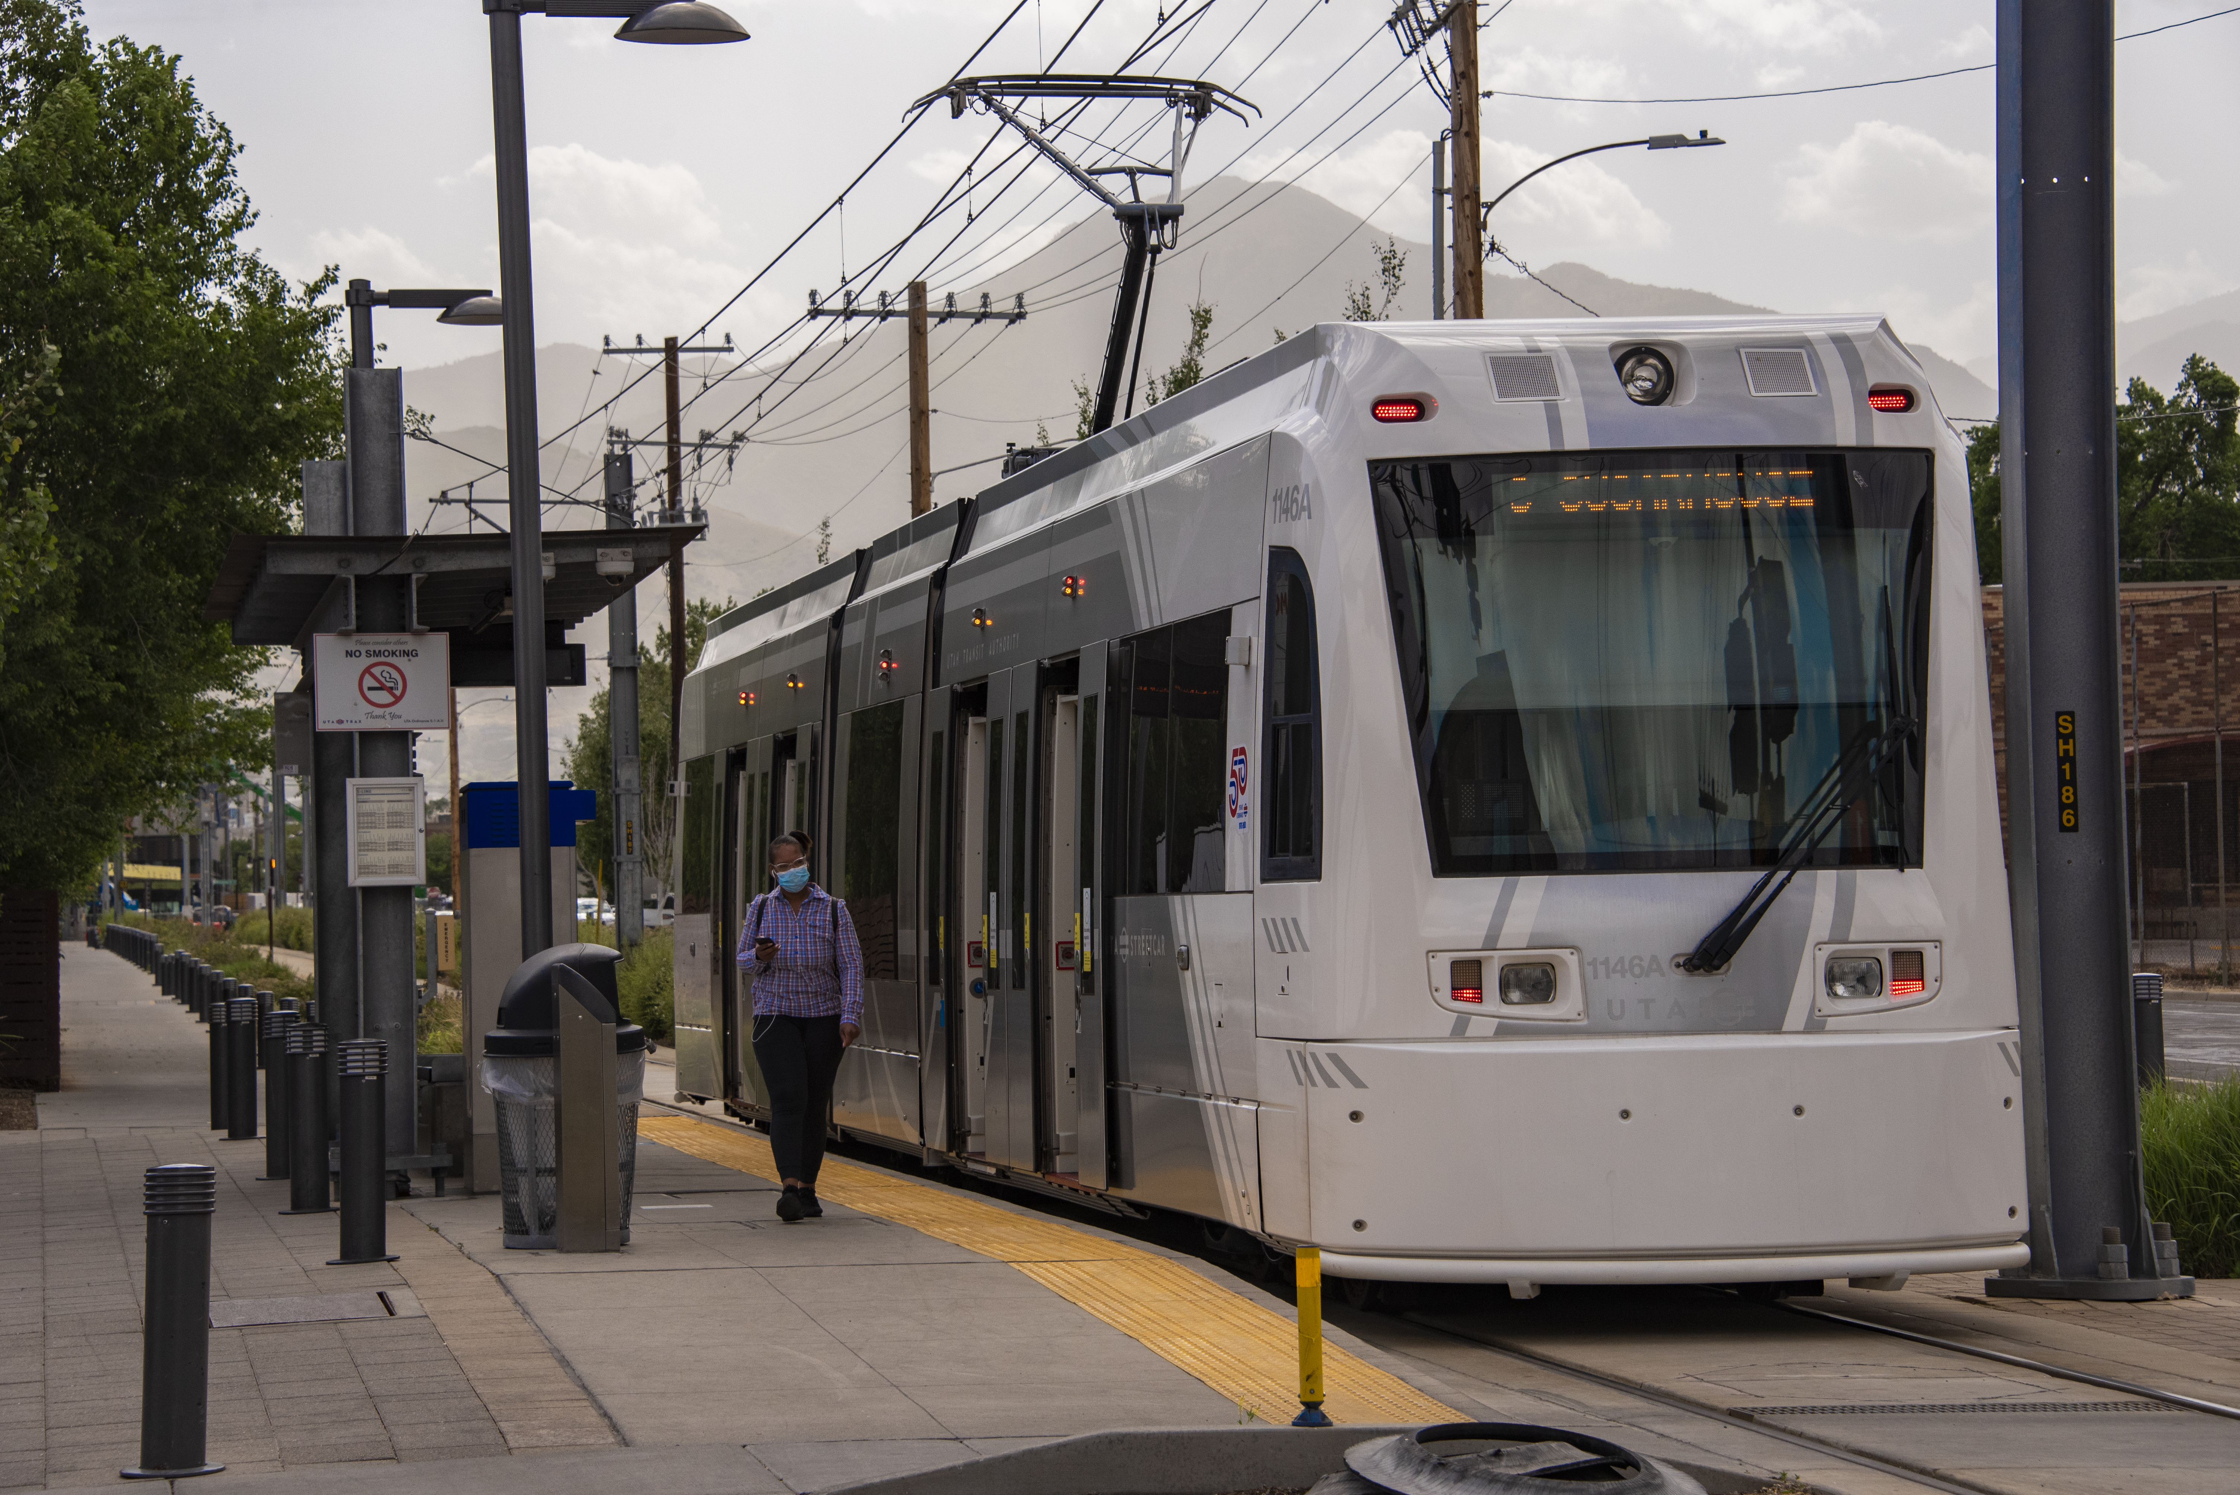
Bus Service Increases
Route 54
Weekday: 15-min
Saturday: 15-min
Sunday: 30-min
Route 205
Weekday: 15-min
Saturday: 15-min
Sunday: 30-min
New Streetcar Station
Highland Drive

Slide 45
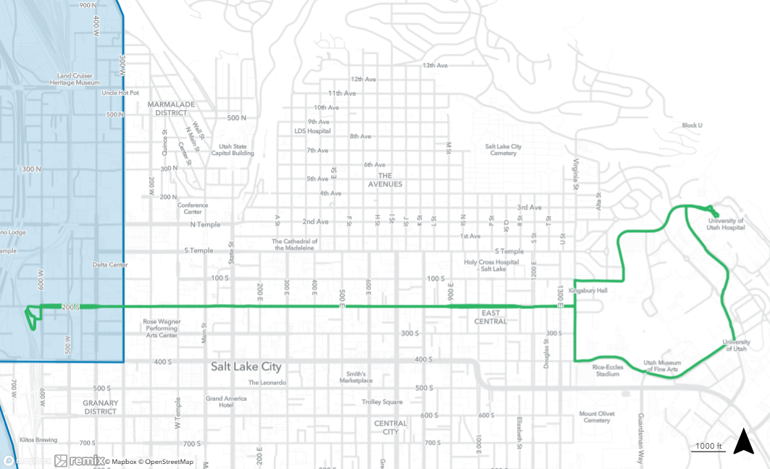
Routes 2A/2B
Provide 6-9 minute service on 200 South (replaces routes 2, 220)
North Campus Dr
2B
2A
Mario Capecchi Dr
2A 2B
University St
2A
2B
Salt Lake Central Station
2A
2B
South Campus Dr

Slide 46
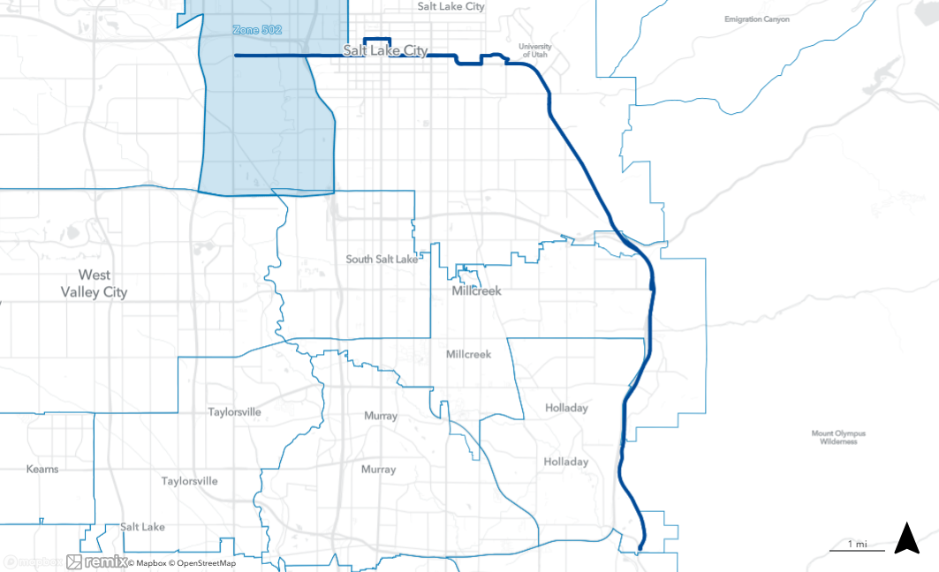
200 S
South Campus Dr
Route 4
Extended to 6200 South/ Wasatch Blvd Park & Ride
200 E
1300 E
W Temple
500 S
Foothill Blvd
Olympus Cove Park & Ride
Wasatch Blvd
6200 South/Wasatch Park & Ride

Slide 47
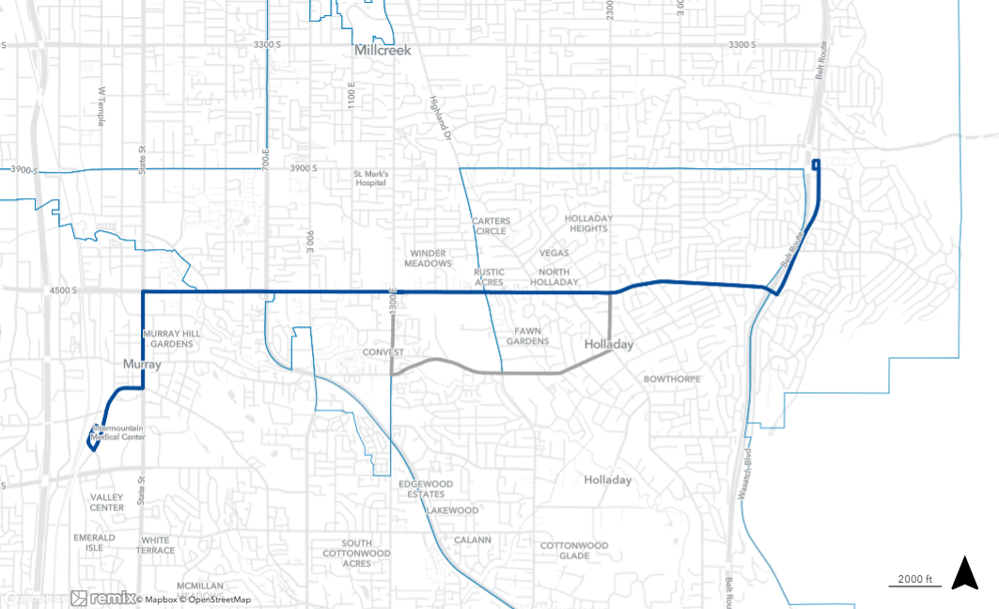
Route 45
Rerouted to serve 4500 South between 1300 East and 2300 East (service on Murray-Holladay Rd replaced by route 223)
Olympus Cove Park & Ride
Wasatch Blvd
2300 E
4500 S
Vine St
Murray-Holladay Rd
Murray Central Station

Slide 48
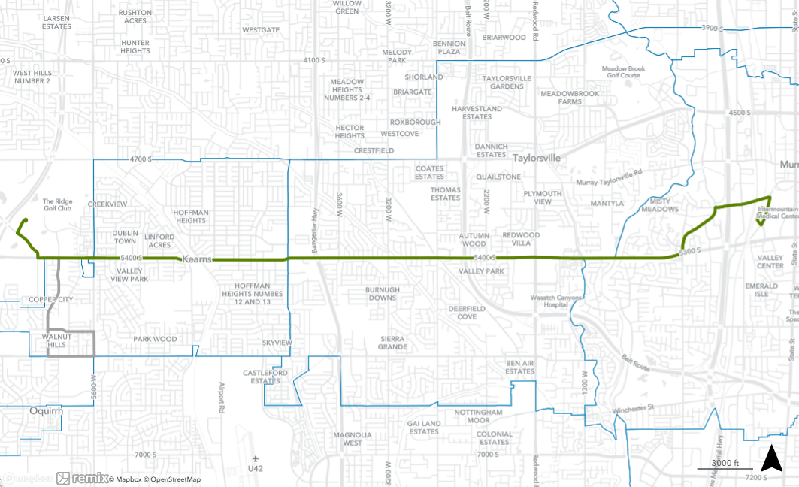
Route 54
Service increased to 15-min on weekdays and Saturdays, 30-min on Sundays
Rerouted to serve UFCU Amphitheatre (service on Copper City Dr replaced by route 62)
Cottonwood St
UFCU Amphitheatre
Vine St
Murray Blvd
Murray Central Station
6055 W
Copper City Dr

Slide 49
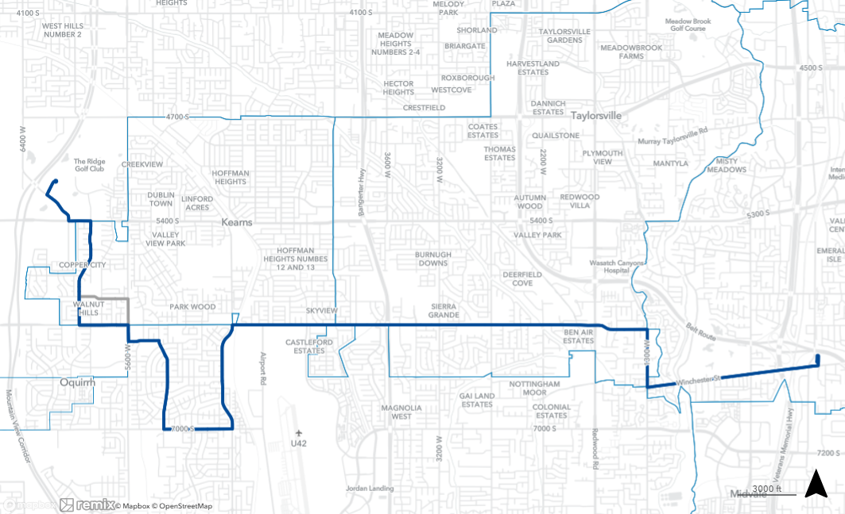
Route 62
Extended to UFCU Amphitheatre (replaces portions of route 54)
UFCU Amphitheatre
6055 W
Copper City Dr
6200 S
Fashion Place West Station
Balsa Ave
4800 W
5330 W

Slide 50
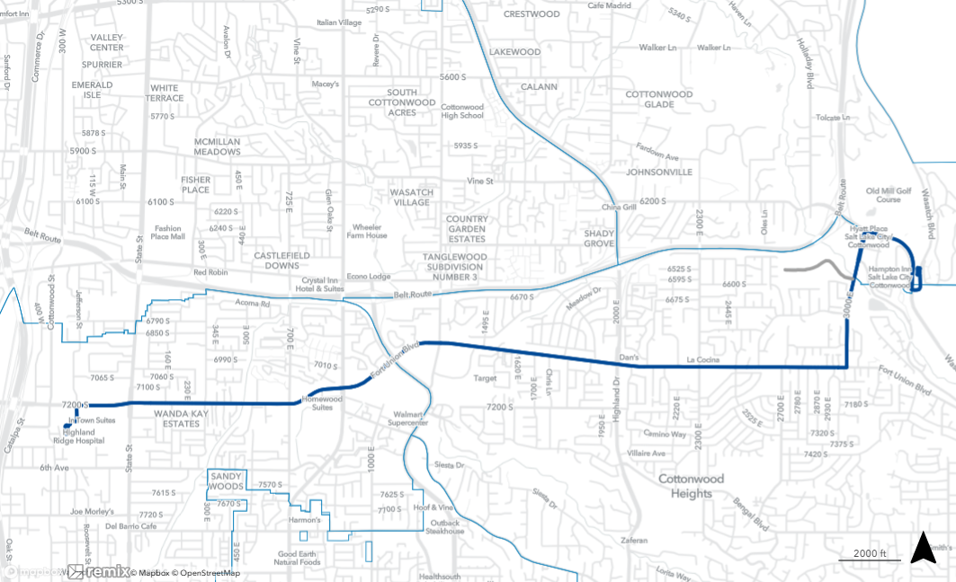
Route 72
Extended to 6200 South/ Wasatch Park & Ride
6200 South/Wasatch Park & Ride
Midvale Ft. Union Station

Slide 51
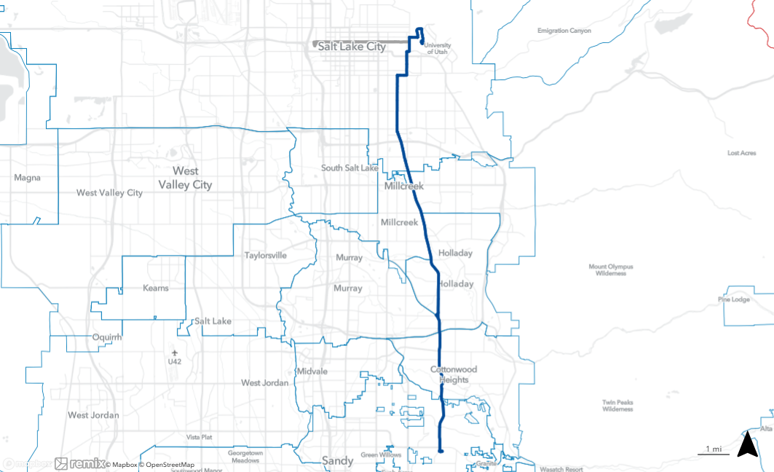
University St
U of U Union
Route 220
Shortened to U of U Union (service on 200 South replaced by routes 2A and 2B)
200 S
1300 E
400 S
900 S
1100 E
Highland Dr
Highland Dr/ 9400 South Park & Ride

Slide 52

North Temple Station
North Campus Dr
Virginia St
Route 223
Extended to Murray Central Station (replaces portions of route 45)
Service increased to 30-min on weekdays
N. Temple
3rd Ave
Wakara Way
100 S
Chipeta Way
Mario Capecchi Dr
Sunnyside Avenue
Arapeen Dr
1900 E
1700 S
1700 E
2700 S
2000 E
3300 S
2300 E
Murray Central Station
Murray Holladay Rd
5300 S
1300 E
5600 S
3000 E
Holladay Blvd
6200 S

Slide 53

Zone 502
Add Central Pointe Station as a start/end point
Central Pointe Station

Slide 54

Service Restoration
Downtown Salt Lake City
1 2A 2B 4 200 205 209
223 451 F453 455 470
472 473
Power Station
1 205 217 417 451 F453 551
400 S. Redwood
1 4 9 205 217
Community Priority
Routes 54*, 205*:
Increase service to 15-min
205
Murray North Station
205
54
Murray Central Station
45 47 54 200 201 223
Hours | Miles | Shifts | Pullout
+45K | +645K | +22 | +7
Notes:
Route 54: 15-minute service prior to Covid, currently 30-min. Identified by UTA's Community Engagement team as a high priority for service restoration from the community.

Slide 55

200 South
University of Utah
1 2A 2B 4 9 F11 17 21
213 220 223 455 473
Salt Lake Central Station
2A 2B 209 509 513
Route 2*:
Replace with 2A/2B*
6-9 min. frequency on Weekdays
Route 220:
Shorten to U of U Union
2A 2B
220
Hours | Miles | Shifts | Pullout
+13K | +114K | +6 | +5
Notes:
Please add the notes for these routes
Start EOL an corridor

Slide 56

Canyon Connections
3900 S. Wasatch
4 33 39 45
Murray Central Station
45 47 54 200 201 223
223
45
Route 4*:
Extend to 6200 S. Wasatch Park & Ride
Extend to LCC Park & Ride
Evaluate routing with UDOT
Route 72:
Extend to 6200 S. Wasatch Park & Ride
Routes 45*, 223*:
Reroute to improve connections, increase coverage
Increase route 223 to 30-min on Weekdays
223
4
6200 S. Wasatch
4 72
Midvale Fort Union Station
72
72
Hours | Miles | Shifts | Pullout
+11K | +308K | +4 | +4
Notes:
Route 4: Identified as a priority by UTA leadership to facilitate upcoming ski improvements per the Little Cottonwood EIS and related studies.
Route 72: Extended to connect with route 4 at the 6200 S. Wasatch Park & Ride
Route 223: Current service on Holladay Blvd is very low productivity—service has remained in place in part due to Paratransit coverage. With the extension of route 4, route 223 service on Holladay Blvd is no longer needed to provide Paratransit coverage, so there is an opportunity to provide additional connections and coverage in Holladay and Murray.
Route 45: Realignment of route 223 allows for route 45 to travel on 4500 South instead of Murray-Holladay Road between 1300 East and 2300 East. This addresses a long-standing gap in coverage and is consistent with longer-term plans for service on this corridor.

Slide 57

S-Line Extension
Route 720: Extend to Highland Drive
Central Pointe Station
17 21
Hours | Miles | Shifts | Pullout
+2K | +24K | +2 | +1

Slide 58
Utah County
April 2026
Notes:
Marcus

Slide 59

Technology Way
1450 N
Vineyard Station
1200 E
800 N
Route 846
New route (replaces portions of route 862)
30-min service weekdays, 60-min service Saturday
800S
University Place
University Pkwy

Slide 60

Route 850
Rerouted to serve Valley Grove area (service to downtown Pleasant Grove replaced by route 862)
State St
Main St
State St
2000 W
Center St
Main St

Slide 61

American Fork Station
850 E
Pioneer Crossing
200 S
Pony Express Pkwy
8000 W
Route 860
New route (replaces route 806)
30-min service weekdays, 60-min service Saturdays

Slide 62

American Fork Station
200 S
State St
Route 862
Rerouted to serve downtown Pleasant Grove, American Fork Station (replaces portions of route 850
Portions of route 862 replaced by new route 846
“Center St
1650 W
Main St
100 S
Pleasant Grove Blvd
State St
1600 N
1200 W
Orem Station
College Dr
1000 S
1200 S
University Pkwy
Geneva Rd

Slide 63

North Utah County
Lehi Station
807 850 871
Route 850:
Serve Valley Grove development
Routes 846*, 860*
New routes to expand coverage, improve connections
Route 862*:
Rerouted to preserve coverage, improve connections
New IMZ Service*
850
860
862
American Fork Station
860 862
Vineyard Station
834 846
846
850
846
Orem Station
581 830X 831 862
862
Hours | Miles | Shifts | Pullout
+39K | +404K | +21 | +8
Includes +1 pullout, +2 shifts for Paratransit

Slide 64
April 2025
Fares Changes

Slide 65
Route 628 Midtown Trolley: Zero to Paid Fare
Route 628 Midtown Trolley (Layton):
Will transition from Zero Fare to paid fare on April Change Day 2025. This service will align with other UTA services at $2.50 for a regular one-way trip.

Slide 66
2025-2026
Additional Fares Changes

Slide 67
Proposed Changes
UTA is starting the final phases of implementation for the new fare collection system. To support the roll out of this project and achieve UTA’s vision of an integrated fare collection system, fare changes are being proposed.
Exact timelines are to be determined.
Ticket options will be phased out and replaced by pre-paid, reloadable accounts.
Proposed changes will impact paper tickets, monthly passes, and tickets sold on the mobile app.
Other proposed fare changes will also be included as part of this change day.
Notes:
In the future, all reduced fares will be managed through UTA's new ABT. Riders will pay a reduced fare using a FAREPAY card. Customers will apply through the ABT system for a discounted fare. With approved eligibility, a discount will automatically be applied to the fare. Fare Capping will also be applied.

Slide 68
Paper Tickets – Proposed Changes
Fares purchased at the ticket vending machines (TVMs) are being simplified. Currently, TVMs vend paper tickets with more than 13 ticket options available to purchase.
The newly installed TVMs are being programmed with new functionality and improved screen flow. They will vend FAREPAY cards.
Customers will be able to purchase FAREPAY cards, load funds to their account using cash or credit payment, and check card balances at all TVMs.
The following full and reduced fare tickets to be replaced include:
  One-way
  Round Trip
  Upgrade Ticket
  Group Pass
  Day Pass
Notes:
In the future, all reduced fares will be managed through UTA's new ABT. Riders will pay a reduced fare using a FAREPAY card. Customers will apply through the ABT system for a discounted fare. With approved eligibility, a discount will automatically be applied to the fare. Fare Capping will also be applied.

Slide 69
Monthly Passes – Proposed Changes
Paper passes have slowly been phased out over the years because of low sales.
  Low sales are the result of an increased adoption of UTA’s current electronic fare payment options.
There were over 16 paper pass options available to purchase and now there are four.
Currently, for customers using the FAREPAY card, best fare is automatically calculated using fare capping technology. Capping is done daily and weekly.
  Fare capping will be carried over as part of the new fare collection system.
The monthly passes proposed to be eliminated include:
  Reduced fare monthly stickers (RFS, XRFS)
  Reduced fare monthly pass (R, XR)
  Full fare monthly pass (A, X)
Notes:
In the future, all reduced fares will be managed through UTA's new ABT. Riders will pay a reduced fare using a FAREPAY card. Customers will apply through the ABT system for a discounted fare. With approved eligibility, a discount will automatically be applied to the fare. Fare Capping will also be applied.

Slide 70
Mobile App – Proposed Changes
Fares purchased through the mobile app are being simplified. Currently, customers can choose from more than 15 fare products.
UTA has not started the development of the new mobile app but proposes reducing the fare products and replacing them with pre-paid reloadable accounts.
  The best fare will automatically be calculated, and customers will not have to choose from multiple fare products.
Fare products to be replaced include:
  Day Pass
  One-way, One-way FrontRunner (full or reduced fare)
  Monthly Regular/Premium (full or reduced fare)
  One-way Ski Pass, Seasonal (full or reduced fare)
  Group Pass (premium pass for 4 people)
  Riders License, Seasonal (discounted youth pass)
  One-way Paratransit (passengers must pre-qualify)
  Flex Route Deviation (flex route only)
  Special Event Pass
Notes:
In the future, all reduced fares will be managed through UTA's new ABT. Riders will pay a reduced fare using a FAREPAY card. Customers will apply through the ABT system for a discounted fare. With approved eligibility, a discount will automatically be applied to the fare. Fare Capping will also be applied.

Slide 71

Paper Transfers – Proposed Changes
Customers paying cash at the farebox will no longer receive a paper transfer.
  Each leg of a multi-mode or multi-route trip would need to be paid separately ($2.50 each)
Paper transfers, a form of fare media, are currently given by bus operators to customers upon request.
  The paper transfer gives customers purchasing a single trip additional time to travel on more than on mode of transit without incurring additional fare cost.
  Currently, transfer credits are automatically applied for fare payment made with electronic fare media.
To receive a transfer credit, cash would need to be paid at TVMs, UTA customer service locations, or retailers by adding funds to a FAREPAY card.
Notes:
In the future, all reduced fares will be managed through UTA's new ABT. Riders will pay a reduced fare using a FAREPAY card. Customers will apply through the ABT system for a discounted fare. With approved eligibility, a discount will automatically be applied to the fare. Fare Capping will also be applied.

Slide 72
Reduced Fares – Proposed Changes
Reduced fare discounts will be managed through UTA’s new account-based ticketing (ABT)
  The ABT will bring all UTA’s current systems under one umbrella, including the reduced fare application portal.
Cash payments made through the farebox will not be eligible for a discount.
  Reduced fare discounts will only be available for customers using electronic fare media
  Customers paying with cash can add funds to an electronic card at TVMs, UTA customer service locations, and retailers.
Reduced fare plastic ID cards will be phased out because they cannot be read or validated by the electronic card readers. Since this card is not compatible with the system, it will be retired.
Notes:
In the future, all reduced fares will be managed through UTA's new ABT. Riders will pay a reduced fare using a FAREPAY card. Customers will apply through the ABT system for a discounted fare. With approved eligibility, a discount will automatically be applied to the fare. Fare Capping will also be applied.

Slide 73


Questions & Comments comments will be given 3 minutes

Slide 74



Public Comment Opportunities
Visit rideuta.com/ChangeDay for more information
Submit comments by December 13, 2024!
Contact us at hearingofficer@rideuta.com
Submit comments by December 13
Online: rideuta.com/ChangeDay
Email: hearingofficer@rideuta.com
Phone: 801-287-3888
Mail: Utah Transit Authority, C/O Jolisha Branch, 669 W. 200 S., Salt Lake City, UT 84101

Slide 75
Next Steps
30 Day Public Comment Period – begins today, November 13 through December 13
Title VI Analysis continues
January 2025
  Title VI analysis finalized
  Public Comments considered
  Plans finalized
February 2025: Board Meeting
  Update on public engagement, service plan, fares plan
  Resolution approving Title VI Analysis
February – April 2025: Inform
  Community education, outreach, communications
  Preparation for any planned changes
April 13, 2025: Change Day
  April 12, 2026

